Slide 1
Vehicle Service Information
Basic Maintenance and Light Repair

Slide 2
Vehicle Service History

Slide 3
Service Manuals
Manufacturer’s manual
Specialized manual
General Repair manual
Notes:
A technician can use service manuals to determine problems associated with a particular car model and make.
Manufacturer’s manual
Covers that specific vehicle produced by a manufacturer during a given model year
Specialized manual
Covers specific areas or sections of a vehicle
They usually come in several volumes, each covering one section or system
General repair manual
These are similar to manufacturer’s manuals but with less detail

Slide 4
VIN
Every car has a unique vehicle identification number (VIN)
Use this number to access and interpret information for repairs and modifications made to that specific vehicle
Use the VIN to look up specific parts for that vehicle
Notes:
For specific problems and solutions for a particular vehicle, the technician must turn to the VIN number of the car.
Each car has a specific VIN number
Use this number to access and interpret information for repairs and modifications made to that specific vehicle
Use the VIN to look up specific parts for that vehicle

Slide 5
Country of Origin
Manufacturer
Vehicle Type
Body Type
Engine
Serial Number
1T2BN38K5CR066405
Plant
Model Year
Check Digit
Model
Restraint Type
Series

Slide 6
Three C’s
Concern, Cause, Correction

Slide 7
Concern
The customer’s complaint about the problems with their car
The information received from the customer
Why listen to the customer?
Shows the customers that you care about getting their vehicle fixed correctly
It communicates to the technician where to begin looking for the problem
Notes:
When writing concern, never assume what the problem is, that is the technicians job
This is the information that is received from the customer
What is the customers concern or another word is complaint
Why you need customer concern?
Shows the customer that you are listening and care about getting their vehicle fixed correctly
It communicates to the technician where to begin to look for the problem
It increase the chance of the vehicle getting fixed the first time

Slide 8
Cause
Technician takes over
Determine if the customer’s complaint is valid
If the customer’s complaint is valid then what needs to be done to fix it
After cause is determined and price is calculated, the manager will call the customer for authorization of repairs
Notes:
This is where the technician takes over
This is where you take the customer’s concern or complaint and determine if it is valid and what it will take to remove the concern
After determining the cause and working up a price for the repair the service manager will usually contact the customer for authorization to make the repairs

Slide 9
Correction
Technician makes the repairs
Technician will also follow up with the customer to ensure that problems is fixed
Test drive, scanners
Notes:
This is the technicians job to make the repairs
A good technician will also follow up with the customer to ensure that the repairs have been fixed and that the customer’s concern has also been fixed.
This might include a test drive over the same roads the customer used to demonstrate the complaint or connecting the scanner and confirming the repair
This makes you a better technicians and reduces comebacks

Slide 10
Work/Repair Order

Slide 11
Work Order
A form used by technicians to record information about a vehicle that is being serviced
Contains owner and vehicle information
Description of compliant
Technician's diagnosis
Name/description/price of parts needed
Hourly/ total charges
Also used as a price indicator and invoice
Notes:
A form used by technicians to record information about a vehicle that is being serviced
The work order is a starting point for the technician when servicing and repairing the vehicle
Identification should include
Owner and vehicle information
Description of complaint and the technician’s diagnosis
Name/description/price of needed part
Hourly/total charges for labor and outside work, sales, tax and total cost
Often used as the invoice for the customer as well as the price estimator
The customer must sign the work order authorizing the shop to repair the vehicle

Slide 12
Total Charges
Part Price (30% upcharge)
Part is originally $25
Upcharge = $25 x 1.30 = $32.50
Tax
Supplies
Fees
Labor
Notes:
Then the technician calculates the total charges
Part price which usually includes a markup price of 30%
If a part is originally $25, they will charge $25 x 1.30 = $32.50
Tax
Supplies
Fees
Labor
Which can either be calculated by that shop’s labor rate times the flat-rate time as given in the flat-rate manual or they can multiply the labor rate by the actual time it took them to complete the repairs

Slide 13
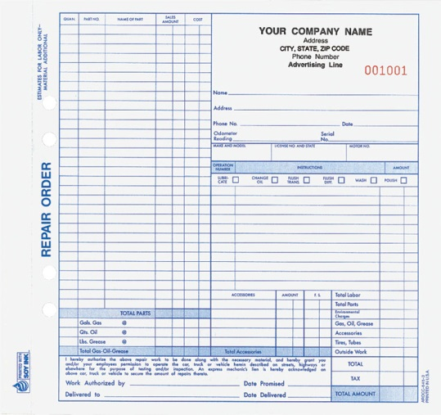

Slide 14
Fender Covers and Mats

Slide 15
Covers and Mats
Fender Covers
Placed over fenders, upper grille, or other body sections to prevent vehicle damage
Seat Covers
Placed over seats to protect them from dirt, oil and grease
Steering Wheel Covers
Floor Mats
Latex Gloves
Notes:
These are used to keep the customer’s property clean or as it was brought in
Fender covers are placed over fenders, upper grille, or other body sections to prevent vehicle damage
They protect the paint or finish from nicks, scratches, and grease
Use a fender cover whenever the hood is opened
Seat covers are placed over seats to protect them from dirt, oil and grease that might be on your work clothes
These covers should be used while driving the vehicle or while working in the passenger compartment
Use steering wheel covers for when the car needs to be driven
Use mats whenever the car door is opened (interior work) and covering everything
Use latex cloves for interior work

Slide 16
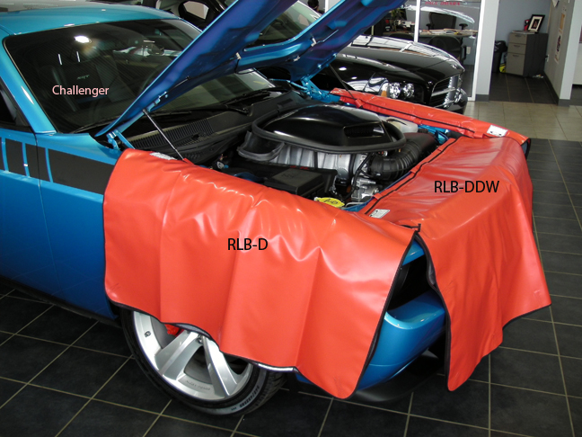
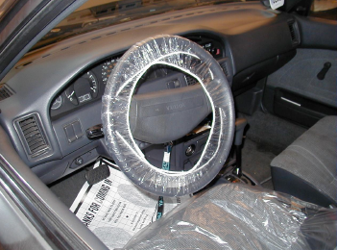

Slide 17
Vehicle Preparation for Return

Slide 18
Preparation to Return to Customer
Gloves, mats and covers are used so no dirt and grease gets on the car
Adjust the seat back to the customers position
Ensure the audio/electronics/air/heat have been adjusted back to the where the customer had it or off
Notes:
Gloves, mats and covers are used so no dirt and grease gets on the car
Adjust the seat back to the customers position
Ensure the audio/electronics/air/heat have been adjusted back to the where the customer had it or off

